Slide 1

TimeStamp
“Timekeeping Made Easy”
Jason Jamil, Steve Haikio, Alex Jabiro, Patric Abbo, Stefen Orban, Mario Saad, Adrian Pekala

Slide 2

Recap
Goal: Develop a project management website
Tools: AWS, Cloud9, EC2 instance server
Languages: MySql, HTML, CSS, PHP, & Bash

Slide 3
Completed Sprint 2
Business registration
Payment plans
Payment processing via Stripe
Table creation in Database
Configuring Cloud9 test environment
Develop plan for Sprint 3

Slide 4
RISKS & CHALLENGES
Setting up GitHub to work with AWS
Setting up and hosting our own AWS server
Working with AWS
Configuring everything in Cloud9 test environment
Cloud9 IDE suffering fatal error and needing to be recreated

Slide 5

DCAA COMPLIANCE
TimeStamp requires the user to enter a reason for editing previously entered data on a timesheet.
The audit trail will contain a detailed activity log. This log includes the username, IP address and a time and date stamp of all entries made to the timesheet.
Employees must enter and record time daily. TimeStamp will send employees who forgot to enter hours worked each day an automated reminder via email.

Slide 6
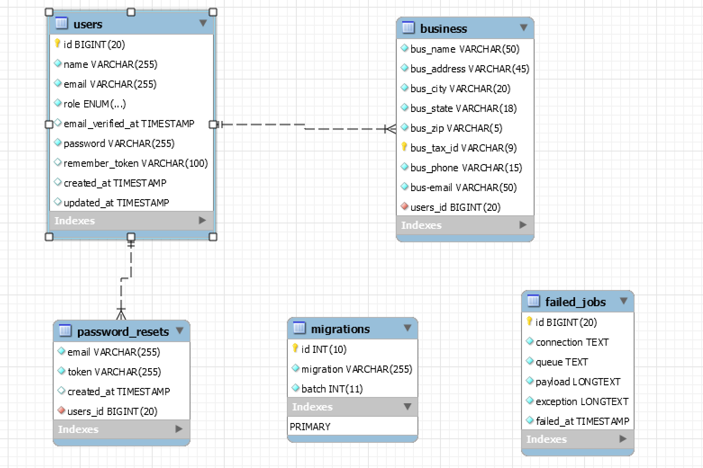
Current
Database

Slide 7
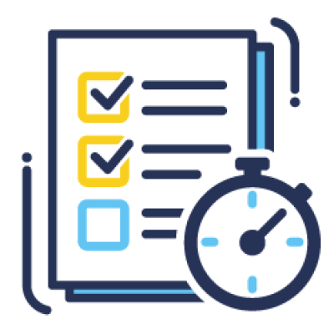
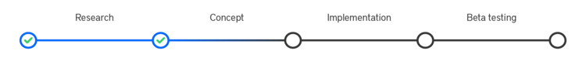
Next Sprint
Registering users and assigning to project: Allow the admin of a business to create user accounts for those that will be working on a project and then assigning them to that project
User time tracking: Add the ability for a user to punch in and punch out of a project allowing for precise time tracking
Begin building audit trail: DCAA compliance requires tracking of all changes made to a project. We will begin building the ability to track those changes. This may require multiple sprints to complete and implement correctly

Slide 8
LIVE
DEMO
TimeStamp
“Timekeeping Made Easy”

